Slide 1

Module 2 Boolean Expressions
Notes:
<number>

Slide 2
Introduction:
Boolean expressions are a fundamental concept in computer science and are used to make decisions in various applications.

Slide 3
Definitions:
Boolean expressions are logical statements that can be either true (1) or false (0). These values represent the two possible states of a binary decision.
Boolean algebra, also known as Boolean logic, is a mathematical system that deals with logical values and operations. It was developed by the mathematician George Boole in the mid-19th century and is named after him. Boolean algebra forms the foundation of digital logic and is closely related to Boolean expressions, these are the building blocks of decision-making in computers.

Slide 4
Components of Boolean Expressions:
The main components of Boolean expressions are operands and logical operators.
Operands are the values or variables used in the expressions (e.g., "A" and "B").
The three fundamental logical operators are AND, OR, and NOT.

Slide 5
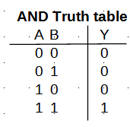
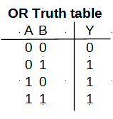
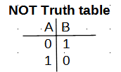
Truth tables:

Slide 6
Combining Boolean Expressions:
Boolean expressions can be combined to create more complex statements.
Parentheses alter the order of evaluation in Boolean operations in a similar way than in arithmetic operations.
In the following expression Y = A AND (B OR C),
we first evaluate the expression B OR C and then AND it with A, as seen in the following table.

Slide 7
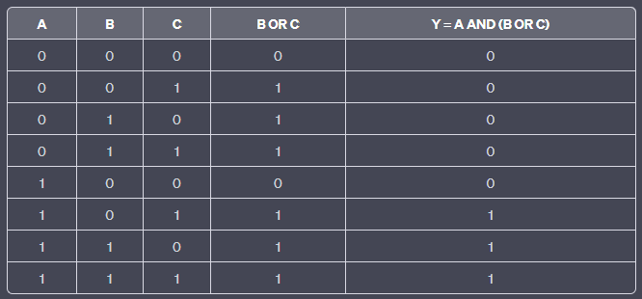
Truth Table for Y = A AND (B OR C):

Slide 8
Steps to evaluate Boolean expressions:
1. Understand the Expression. (Meaning of each operator AND, OR, NOT).
2. Identify the Variables. (Take note of all the variables and assign values, True or False).
3. Resolve Parentheses. (Start with innermost parentheses and following order of operations).
4. Apply NOT Operator. (NOT operator inverts the truth value).
5. Apply AND Operator. (Evaluate the expressions connected by the AND operator).
6. Apply OR Operator. (Evaluate the expressions connected by the OR operator).
7. Final Evaluation. (Simplified expression, truth value either True or False).

Slide 9
Activity:
Following the 7 steps to evaluate Boolean expressions, evaluate the following expression providing an explanation for each step and the final evaluation result.
Expression to evaluate:
(A AND B) OR (NOT C)
Given the following variable values:
A = True
B = False
C = True

Slide 10
Activity:
Solution:
Steps:
Expression: (A AND B) OR (NOT C)
Variables: A, B, C
Given values: A = True, B = False, C = True
Resolve Parentheses: Order is altered by parentheses.
Apply NOT Operator: NOT C = NOT True = False
Apply AND Operator: A AND B = True AND False = False
Apply OR Operator: False OR False = False
Final Evaluation: The expression evaluates to False.

Slide 11
Comparison symbols & Boolean expressions:
It is possible to include comparison symbols in Boolean expressions.
Typical comparison symbols to include are:
">" greater than
"<" less than
"==" equal to
"<=" less than or equal to
">=" greater than or equal to
For example, see this expression:
(A > B) AND (C == 10) OR (B <= 5 AND NOT (A == 7))
In few days, you will creating similar expressions once you create your own algorithms and programs.

Slide 12
Comparison symbols & Boolean expressions:
Let’s evaluate this expression:
(A > B) AND (C == 10) OR (B <= 5 AND NOT (A == 7))
Where: A = 8, B = 3, C = 10
Apply comparison symbols:
(A > B) becomes (8 > 3) -> True
(C == 10) becomes (10 == 10) -> True
(B <= 5) becomes (3 <= 5) -> True
(A == 7) becomes (8 == 7) -> False
Apply NOT Operator: NOT (A == 7) -> NOT False -> True
Apply AND Operator: (8 > 3) AND (10 == 10) -> True AND True -> True
Apply AND Operator: (3 <= 5) AND (NOT (8 == 7)) -> True AND True -> True
Apply OR Operator: True OR True -> True.

Slide 13
Summary:
We will be using Boolean expressions while creating our programs to allow decision-making. The same idea applies for electronic circuits and search engines.
Optional material (no for grading):
https://openbookproject.net/thinkcs/python/english3e/conditionals.html
https://www.digitalocean.com/community/tutorials/understanding-boolean-logic-in-python-3

